Slide 1
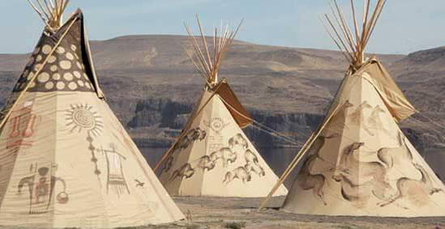
Native American Teepee’s

Slide 2
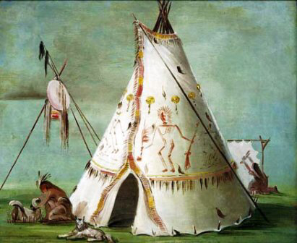
Teepees were the homes of the indigenous, nomadic tribes of The Great Plains. A teepee was built using a number of long poles as the frame. The poles were tied together at the top and spread out at the bottom to make an upside down cone shape. Then the outside was wrapped in a large covering made from animal hide. Native Americans expressed themselves with the artwork that they used on the animal hides. Painted pictures often told stories about a great warrior’s adventure or even pictures of dreams!

Slide 3
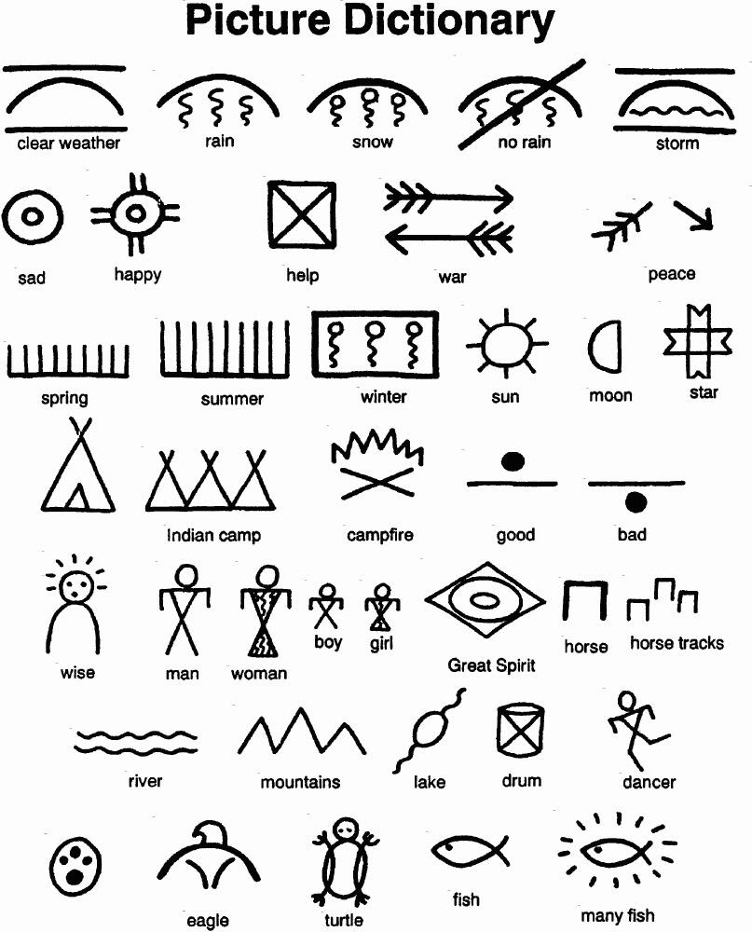
The Native Americans used symbols like these to communicate their stories and ideas.

Slide 4
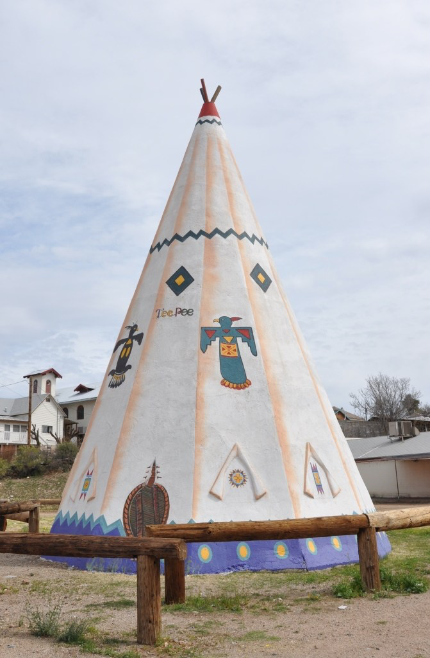
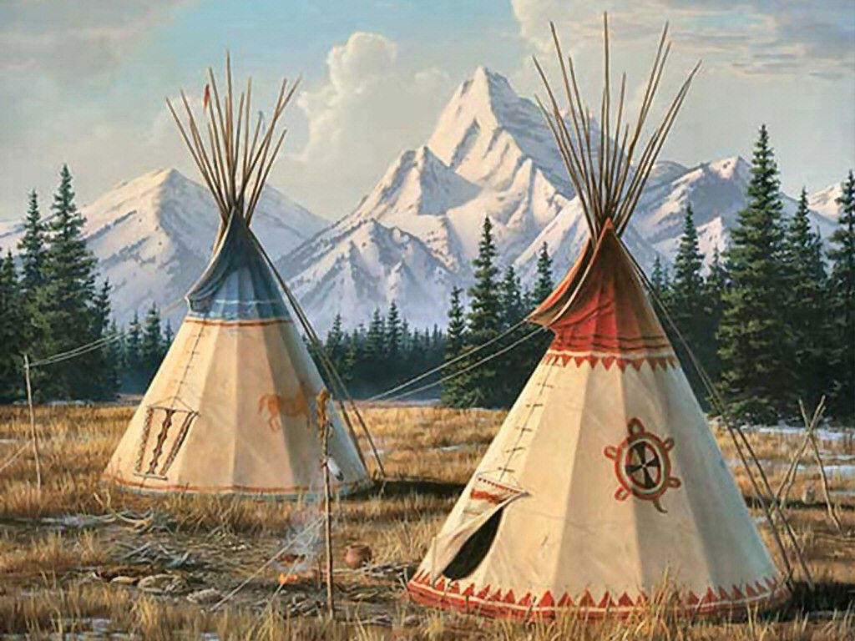
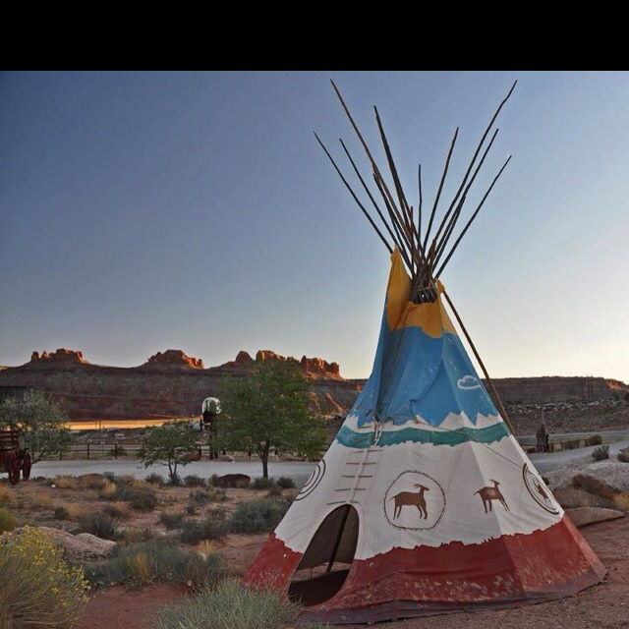

Slide 5
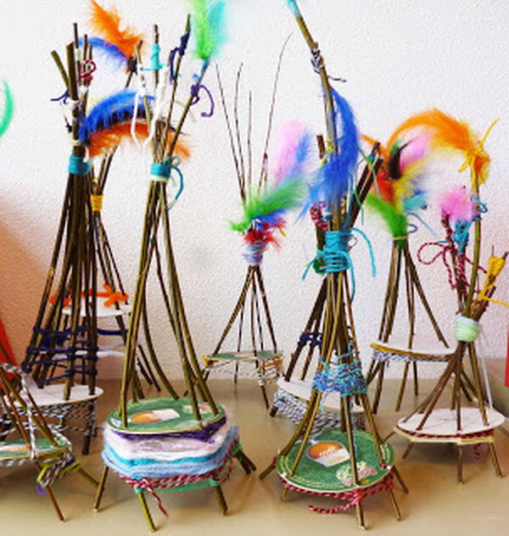
Today we will make our own colorful, creative teepees using small sticks, yarn, beads, string, wire and feathers.

